Slide 1
Java Basics

Slide 2
Identifiers
In Java, identifiers are the names used to identify variables, methods, classes, packages, or other elements in the code.
Rules for Java Identifiers
Character Set:
An identifier must begin with a letter (A-Z or a-z), a dollar sign ($), or an underscore (_).
Subsequent characters can include letters, digits (0-9), dollar signs, or underscores.
No Reserved Words:
Identifiers cannot be the same as Java keywords (e.g., class, public, static, int).
Case Sensitivity:
Java is case-sensitive, so myVariable and MyVariable are two different identifiers.
No Spaces:
Spaces are not allowed in identifiers (e.g., my Variable is invalid).
Length:
There is no theoretical limit to the length of an identifier, but keeping them concise and meaningful is good practice.

Slide 3
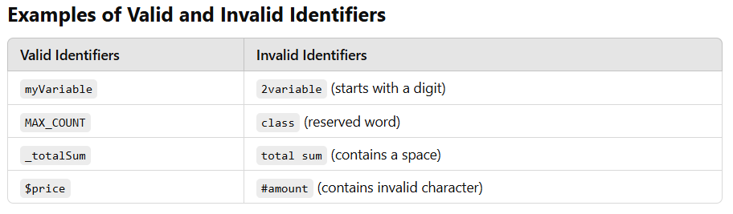
Best Practices -
Use meaningful names for better readability. For instance:
Variables: Use camelCase (e.g., totalAmount).
Constants: Use uppercase letters with underscores (e.g., MAX_LIMIT).
Classes: Use PascalCase (e.g., CustomerData).
Avoid single-letter names unless used for temporary variables (e.g., i, j in loops).

Slide 4
Example –
// Correct usage of identifiers
public class HelloWorld {// 'HelloWorld' is an identifier for the class
public static void main(String[] args) {
int totalScore = 100; // 'totalScore' is an identifier
final int MAX_SCORE = 200; // 'MAX_SCORE' is a constant identifier
System.out.println("Total Score: " + totalScore);
}
}

Slide 5
Java Keywords
Java keywords are reserved words predefined by the Java language.
They have special meanings and are used to perform specific tasks in the code.
Because they are reserved, They cannot be used for naming variables, methods, classes, or other identifiers.
Examples – int, float, class, static public etc.
In total there are 52 keywords in java. Out of which ‘const’ and ‘goto’ are reserved keywords that are not currently used in Java but are kept for future use

Slide 6
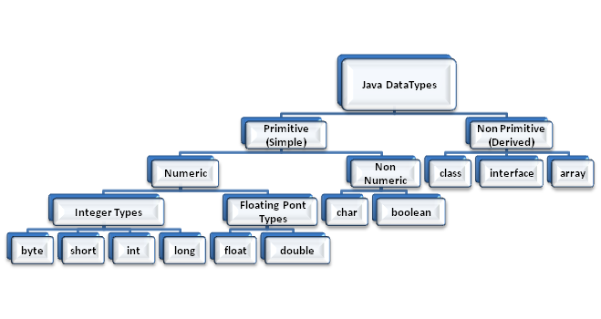
Java Datatypes
Every variable has a type associated with it, that describes the size and type of value that variable can contain. This type is known as Data Type. Java supports the following types of Data Types-

Slide 7
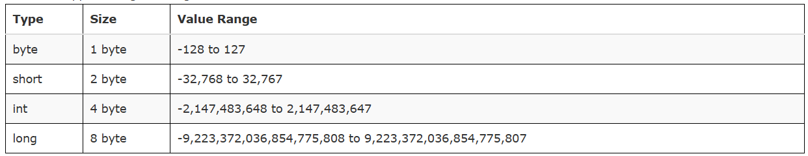
Types of Java Data type –
Data types can be categorized into 2 categories - 1. Primitive Data types 2. Non Primitive Data types
1. Primitive Data types -
Java defines 8 primitive data types - byte, short, int, long, float, double, char and boolean.
Integer Types -
Java support 4 integers types- byte, short, int and long all are signed integers i.e. can store both positive and negative values.

Slide 8
public class Demo2
{
public static void main(String[] args)
{
byte a = 10;
short b = 20;
int c= 30;
long d = 40l;
//Note we use lower case 'l' to denote a long value
System.out.println("value of a:"+a);
/* '+' is used to concatenate something with any string
and make a new string */
System.out.println ("value of b:"+b);
System.out.println ("value of c:"+c);
System.out.println ("value of d:"+d);
}
}

Slide 9
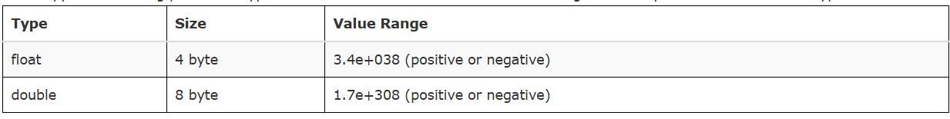
Floating Point Types -
Java supports 2 floating point data types - float and double. For number containing fractional part we use these data types.
Note -
Larger the size of data type, larger the time required for its manipulation. So don't use larger size data type unnecessarily i.e. if you need to store a value 12 for example then use byte data type in place of int or long etc to improve the execution speed.

Slide 10
Example –
public class Demo3
{
public static void main(String[] args)
{
float a = 10.123f;
//Note we use lower case 'f' to denote a float value
double b = 20.123;
//By default floating point types are double, so no need to add any postfix for double data type.
System.out.println("value of a:"+a);
System.out.println ("value of b:"+b);
}
}

Slide 11
Characters Type -
To store character java support char data type. In java char is 2 byte Unicode character that defines fully international character set that can represent all of the characters found in most human languages.
We can also perform arithmetic operations on characters, char can be thought of integer type.

Slide 12
Example –
public class Demo4
{
public static void main(String[] args)
{
char ch1, ch2, ch3, ch4;
ch1 = 'A';
ch2 = 'B';
ch3 = 65; // ASCII value of A
System.out.println("values of ch1, ch2 and ch3 are:"+ch1+" "+ch2+" "+ch3);
ch1++;
ch4 = ch1;
int a = ch1+ch2;
System.out.println("values of ch4 and a are:"+ch4+" "+a);
}
}
Notes:
Output -
values of ch1, ch2 and ch3 are:A B A values of ch4 and a are:B 132
Description -
In the program ch1 and ch2 are assigned the values 'A' and 'B'. Ch3 is assigned a value 65 which is ASCII value of 'A'. So if we print the value of ch3 that will be 'A'. We can also increment/decrement value of characters so ch1++ will increment the value of ch1 by one character so new value of ch1 will be 'B'. When we perform any arithmetic operation on characters they will be automatically promoted to int data type that's why when we add ch1 and ch2 result is stored in integer 'a' and the value of 'a' is addition of ASCII equivalent of 'A' and 'B'.

Slide 13
Boolean Type -
To support Boolean values (true or false) java provides 'boolean' data type. It require only 1 bit to store boolean value in memory. Note :- we cannot use 0 for false and non zero value as true in java, as in C or C++.
public class Demo5
{
public static void main(String[] args)
{
boolean a,b;
a = true;
b=false;
System.out.println("values of a and b are:"+a+" "+b);
}
}
2. Non Primitive Data types -
There are several non primitive data types supported by java like class, interface etc. These will be covered next.

Slide 14
Data Types Conversion and Casting
In programming there can be situation when we required to change the data type of a variable to some other data type, this process of data type conversion is known as type conversion or type casting.
Types of type casting -
Type casting can be categorized into 2 categories based on whether the two types are compatible or not –
1. Compatible Type conversion -
Java perform automatic type conversion if two types are compatible, and destination type is larger than the source type. For example a long type is large enough to contain all valid int or short or byte type, similarly double is large enough to hold any valid float type. This process of storing smaller data type values into larger compatible data type is known as widening.

Slide 15
byte a=10;
int b=a;
float c=b;
// Note that float is larger than integer types (byte, short, int, long)
All numeric data types, integers (byte, short, int, long) and floating point type (float, double) are compatible with each other.
2 - Incompatible Type Conversion -
If two types are not compatible then we can convert the source type into destination type as follows –
type variable1 = (type) variable2;

Slide 16
Example -
int a=10;
byte b = (byte)a;
short c = (short)a;
This process of storing larger data type values into smaller data types is known as narrowing. Note - We can cast integers as well as floating point types into any data type except boolean.

Slide 17
Example -
public class Demo
{
public static void main(String[] args)
{
byte a=10;
int b = 297;
float c = 301.1f;
char d = 'A';
/* compatible type conversion */
int e = a;
double f = c;
float g = b;
System.out.println("values of e, f and g are :"+e+" "+f+" "+g);
/* Incompatible type conversion */
byte h = (byte)b;
float i = (float)f;
System.out.println("values of h and i are :"+h+" "+i);
}
}

Slide 18
Output -
values of e, f and g are :10 301.1000061035156 297.0
values of h and i are :41 301.1
Note :- the value of 'h' is 41 this is because the integer value 297 is out of the rang of byte, in such case value will be reduced by finding the modulus (reminder of division) by the byte range (256). (When 297 is cast to byte the result is reminder of the division of 297 by 256 i.e. 41).

Slide 19
Automatic Type Promotion in Expressions Evaluation -
While evaluating any expression containing byte, short or char operands, java automatically promotes them into int. The reason behind this is that as range of these data types is limited, so while evaluating any expression there are high chances that result may go out of range of these data types, that's why java automatically promote them into int to avoid such conditions. For example –
byte a = 75;
byte b = 30;
int c = a*b;
If we want the result of same data type than we have to manually type cast them as follows –
byte a = 10;
byte c =(byte) a*5;

Slide 20
Note :- In any expression evaluation that contains variables of different data types, the result of evaluation will be promoted to largest data type available in expression.
In any expression first of all byte, short and char are promoted to int. Then if there is a long variable than whole expression will be promoted to long, similarly if there is any float variable then whole expression will be promoted to float and so on.
Example –
int x = 10;
float y = 5.5f;
float result = x + y; // x is promoted to float
System.out.println("Result: " + result); // Outputs: 15.5

Slide 21
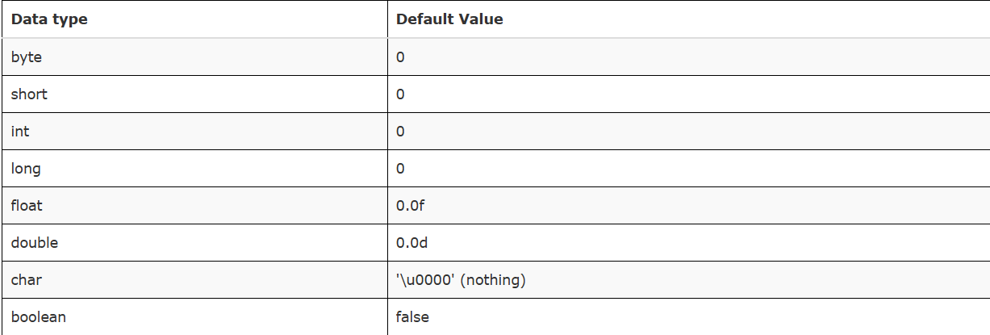
Standard Default values -
When we declared variables for the first time, java automatically assign some default values to them as shown below -

